Slide 1
Units 13 Chapter 17
OLIGOPOLY

Slide 2
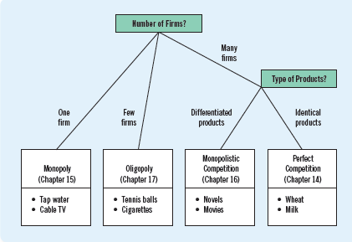
MARKET WITH A FEW SELLERS

Slide 3
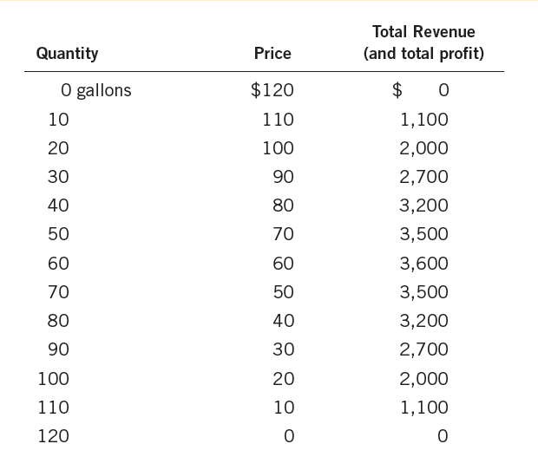
MARKET WITH A FEW SELLERS
Tension among sellers between cooperation and self-interest
Most better off when cooperate and act as a monopoly
Each oligopolist has incentives to pursue self-interest
Duopoly example
Jack and Jill gathering water
MC is assumed as zero
Downward sloping demand
TR is total profit also, as MC=0
Competitive outcome
P = MC
Monopoly outcome
P > MC

Slide 4
MARKET WITH A FEW SELLERS: equilibrium
Collusion: an agreement among firms in a market about quantities to produce or prices to charge
Cartel: a group of firms acting in unison
If the producers collude on equally sharing monopoly quantity, each gets a profit of $1800 from 30 units
Each member wants larger share of market to get more profit
If Jack produced 40 units instead of 30, a total of 70 units would be sold at $50
Total profit is $3500 but Jack’s profit is $2000
If Jill also did the same, total quantity would be 80 and profit would be $3200
Pursuing self-interest => producing a quantity greater than the monopoly, selling at lower than price, and earn total profit less than the monopoly
Producing 40 units is optimal for Jack and Jill as more production reduces individual profits – Nash equilibrium

Slide 5
MARKET WITH A FEW SELLERS: market outcome
Size of oligopoly and effect on market outcome
If two more producers join the Jack and Jill, they could cooperate as monopoly
They can also decide on how much to produce – each other
Each producer has an incentive to recede the agreement by increasing the quantity produced
Output effect: increase in quantity increases profits as MC is zero
Price effect: increase in quantity reduces prices and reduces overall profits
Depending on the relative magnitude of the effects, decisions are made
As number of sellers in an oligopoly grows
Oligopolistic market increasingly resembles a competitive market
The price approaches marginal cost, and the quantity produced approaches the socially efficient level

Slide 6
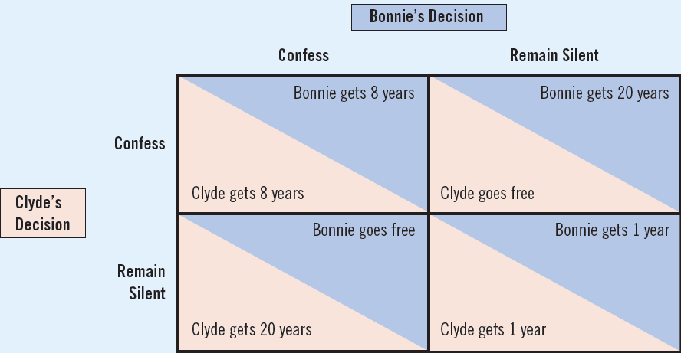
ECONOMICS OF COOPERATION: prisoner’s dilemma
Bonnie and Clyde are caught for a minor crime
Both suspected for a bigger crime, without evidence
Police put an option……
BONNIE
For Bonnie confessing is the best strategy irrespective of what Clyde does
For Clyde confessing is the best strategy irrespective of what Bonnie does
CLYDE
Confessing as the dominant strategy
Both confess and end up in 8 years of prison

Slide 7
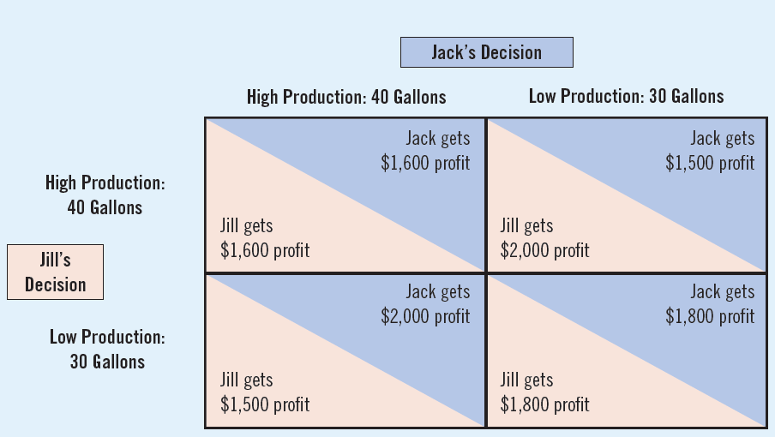
ECONOMICS OF COOPERATION: application
For Jack and Jill, breaking the agreement brings more profit
But they end up with lower profits and higher quantity produced

Slide 8
PUBLIC POLICY ON OLIGOPOLY: India
Competition is desirable than cooperation of oligopoly firms
Restrictive trade practices
Resale price maintenance (tyres and tubes, engineering and electrical goods)
Predatory pricing (TATA Indicom second billing)
Tying behaviour (HP printers at MC. and HP ink with markup)
Public policies aimed at restraining firms from cooperation in India
Monopolies and Restrictive Trade Practices Act 1969
Reducing economic and market power in the hands of a few firms
Controlling unfair trade practices
Competition Commission of India (CCI) 2003
Competition Act 2002
Competition (Amendment) Act 2007

